Slide 1
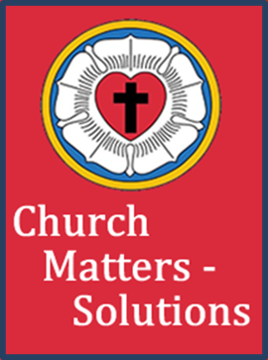
The History of Christian Reformers
From the Early Church to the 16th Century

Slide 2

Chronology of the Christian Church
The Christian Church was initiated through the ministry of Jesus Christ and the 12 Apostles, plus Paul.
The formal church began on the Day of Pentecost, when Jesus died and ascended into heaven.
The first appearances of the ichthys in Christian art and literature dates to the 2nd century.

Slide 3
Chronology of the Christian Church
The early Christian church became legal by decree during the reign of Constantine the Great, the Holy Roman Emperor. (He was a convert to Christianity.)
This event took place in A.D. 313 and the emperor became the head of the Christian Church.
Subsequently, the church grew in areas all around the Mediterranean Sea.
The Roman Empire capitol moved to the new city of Constantinople in A.D. 333.
Notes:
The beginning of church and state being combined.
He coaidered hislf as a bishop of the church

Slide 4
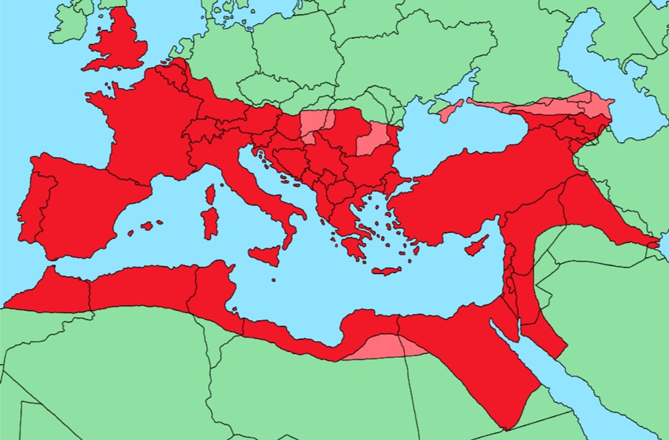
Notes:
1. Greatest extent of the empire super emposed on current states.

Slide 5
Chronology of the Christian Church
Prior to A.D. 333 the early Christians elected overseers (Bishops) over the flock in each major city having Christian populations.
Jerusalem elected James, the half brother of Jesus.
Peter was elected as Bishop of Antioch, Turkey.
Mark, disciple of Paul, was elected as Bishop of Alexandria, Egypt.
There is tradition that Peter was the first Bishop (Pope) of Rome, but historical evidence suggests that it was Linus as both were in Rome prior to Paul's death.
The Emperor initially served as Bishop of Constantinople; however, a Bishop was elected later.
Notes:
1. It was possible in the Byzantine Empire to move up the ranks to Emperor, but when the Emporer married a sex worker something had to change.

Slide 6
Chronology of the Christian Church
Five centers of Christian activity evolved; Constantinople, Antioch, Jerusalem, Alexandria, and Rome; with the latter four leaders known as Metropolitans.
Leadership was elected by what became known as the laity.
Important matters of church government and theology were addressed at Church Councils held about every 100 years.
The first creed of the Christian Church was the Apostles’ Creed, which is evidently an elaboration of a “rule of faith” in use in Rome around 150 AD.
Notes:
Sometimes less sometimes longer.

Slide 7
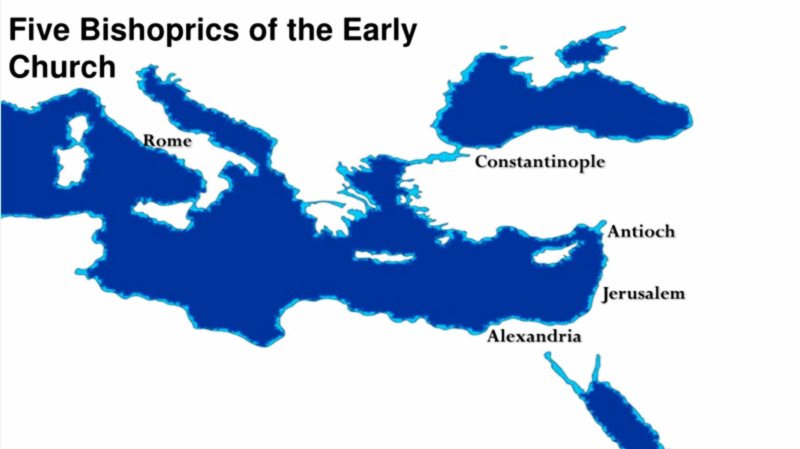
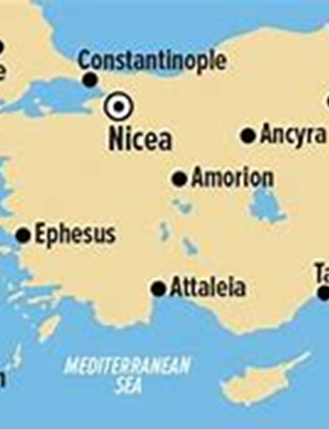

Slide 8
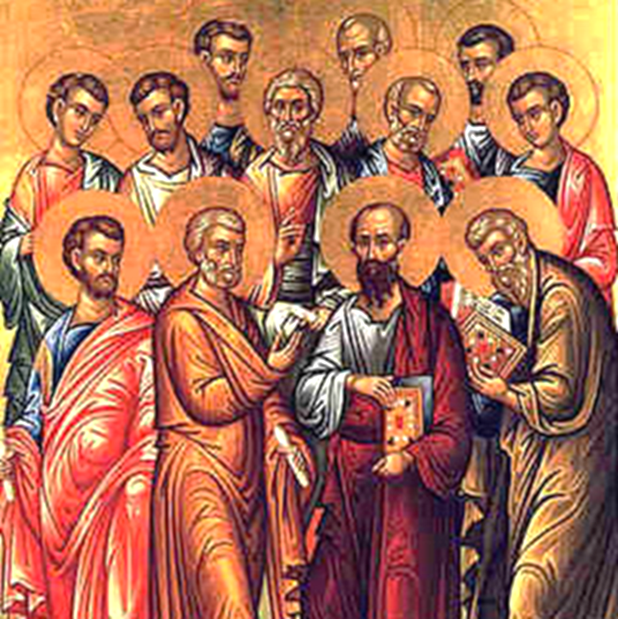
Chronology of the Christian Church
¹The Apostles’ Creed thus became a mark as well as a bond of unity. It was a declaration not only of the faith of individuals, but also of the fellowship, and thus is a church creed. 1 Studies in the Lutheran Confessions, W. D. Allbeck.

Slide 9
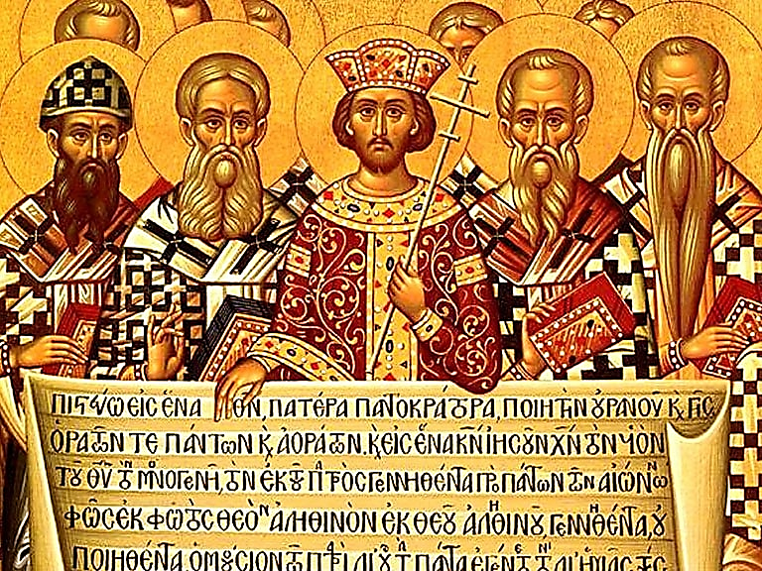
Chronology of the Christian Church
Emperor Constance called the first general ecumenical council in Nicaea, in A.D. 325 to settle questions of doctrine, combat heresy, and work out disputes between different sects.
The Nicene Creed was adopted with the enjoiner that anyone disagreeing with the creed would be labeled a heretic.
Today some denominations use this creed during communion services.

Slide 10
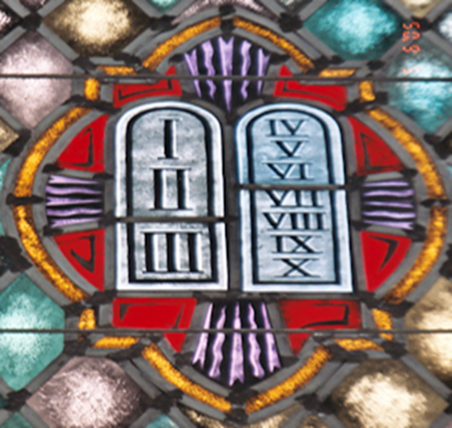
Chronology of the Christian Church
Summary of early theology statements.
10 Commandments from the NT.
The Apostles’ Creed reached final form in A.D. 700 and is also used for baptisms.
The Nicene Creed, adopted by the First Council of Nicaea in 325 and modified by the Council of Constantinople, A.D. 381.
The Athanasian Creed is conjectured to have been written during the A.D. 500 period.
In earlier times it was viewed as a canticle because it was sung in the early churches.
First table is about loving your God, while the second table is about loving your neighbor.
Notes:
Th Athanasian author is unknown , sung responsively.
Proper depiction of the tables.

Slide 11
Chronology of the Christian Church
The first split in the church came at the Council of Chalcedon in A.D. 451 where the second person of the Trinity, the Son, was defined by Orthodox Christians as having two natures, divine and human.
A variation of the two natures was held by the Alexandrian delegation.
This resulted in their ouster as heretics; thus, the Coptic Christian Church was formed, with its locus in Alexandria, Egypt.

Slide 12
Chronology of the Christian Church
Heretics were considered outside the official church, much like excommunication today.
In later times heretics in the Western Church (Roman Catholic) were considered unfit to live and could be killed by anyone without penalty.
Sometimes a “show trial” was held, but the outcome was the same, i.e. Guilty as Charged.
The Eastern Orthodox churches were not as strict on this point.

Slide 13
Chronology of the Christian Church
The “Great Schism” separated the eastern churches from the western churches, i.e. Constantinople and Rome.
Both church politics and theology were the cause.
Politically, Rome was constantly asserting its dominance over the other Bishops.
Theologically, Rome had unilaterally made changes that were not agreed at a council.
Notes:
No longer in communion.
Split over long simmering issues.

Slide 14
Chronology of the Christian Church
From the death of the Church Fathers to the middle ages, Christianity went through many changes. The most notable one was the Great Schism and the rise of the Roman Catholic Church in the west.
The Roman Catholic Church began teaching new doctrines 593-1215; i.e. like transubstantiation of Christ, purgatory, justification by works, and indulgences. They believed their authority was on par with the Holy Scriptures because of the apostolic succession— a claim that all the popes could be traced back in an unbroken succession to Peter.
Notes:
1. The Donation of Constantine (Latin: Donatio Constantini) is a forged Roman imperial decree by which the 4th-century emperor Constantine the Great supposedly transferred authority over Rome and the western part of the Roman Empire to the Pope.

Slide 15
Chronology of the Christian Church
The control exercised by the Roman Church resulted in a strangling of knowledge except for churchmen and royalty.
Plus, a “dumbing down” process for the people, leading too much of the “darkness” of the Dark Ages, and the backwardness of Europe and other areas effectively controlled by Rome.
One other anomality was the creation of a peculiar political institution in Europe called the Holy Roman Empire. (A.D. 800)
The East (Byzantine) was truly an empire, while the West never was, as it was composed of shifting alliances, city-states, and small countries having nothing positive in common.
Notes:
The first emperor was the King of the Franks, which brought Christianity to the Germanic peoples.
This Empire lasted until 1806 and morphed into the lands controlled by the King of Germany (Kaiser)

Slide 16
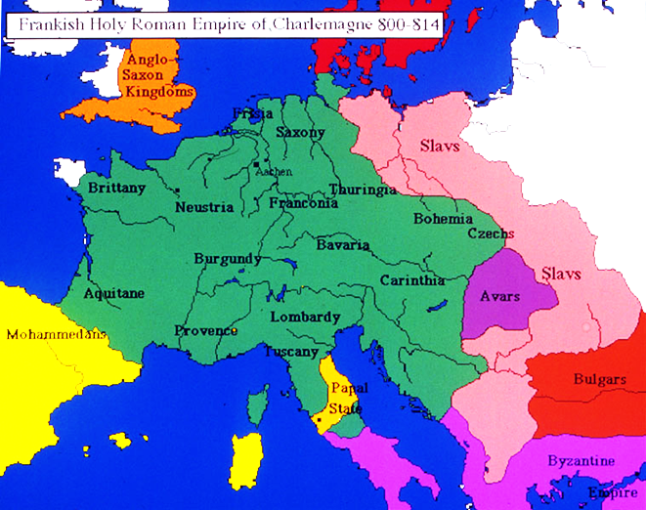
Notes:
1. Officially the State of the Church,^{[7]} were a conglomeration of territories on the Italian peninsula under the direct sovereign rule of the pope from 756 to 1870.

Slide 17
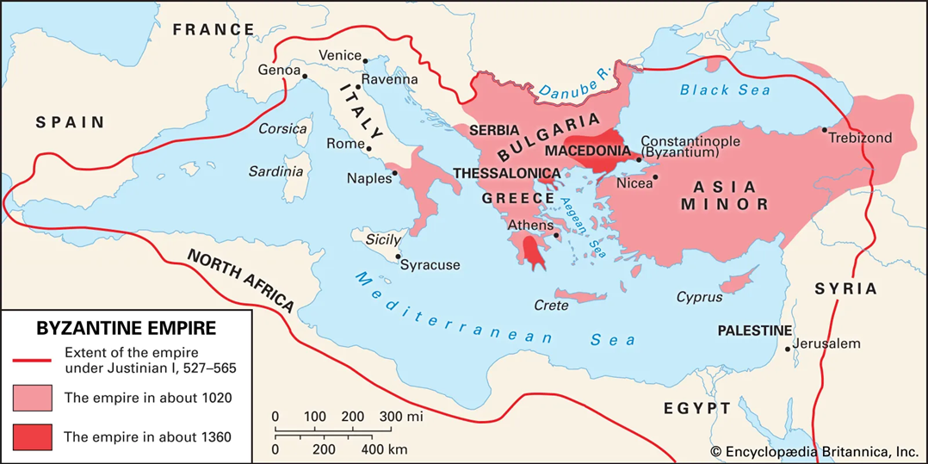

Slide 18
Chronology of the Christian Church
The name of the Holy Roman Empire as it is known today did not come into general use until 1254.
It was Roman to the extent that it tried to revive, without success, the political authority of the Roman Empire in the West, as a countermeasure to the Byzantine Empire in the East.
Included was an attempt to establish the Roman Catholic Church as the supreme authority over heads of state in the empire, which was not always successful and often resented.
Included were attempts by the popes to coronate the kings of the countries in the empire.
Notes:
1. Coronation of Bonaparte.

Slide 19
Chronology of the Christian Church
However, many people protested the authority of the Roman Catholic Church and its new teachings. These formal objections eventually led to the reformations in the 1500’s.
These changes in Rome’s teachings were de facto and not agreed by councils as was done in the early church period.
Most reformations led to a new church body being formed.
Eastern Orthodox churches took note, but did not have reformations.
The following slides illustrate a few of the major reformers that are recorded in history.
Notes:
Eastern orthodox includes Greek and Russian, plus other eastern Europe countries later on.
Many orthodox churches have a presence in the US.

Slide 20
Introduction to the Reformers of the Western Church, i.e. Roman Catholic Church
Much of the dissent was a reaction to the increasing corruption (Both theological and political) of the Roman Catholic Church spanning from the 2nd century through the 16th century.
In each case the reformer made clear attempts to turn back the present to what Scripture said, not what man said.
To keep things brief we will primarily be addressing:
Lifespan events.
Main points for dissent and results.
How they died.
Notes:
1. In addition., to these discussed here there actually others that could be designated as precursors.

Slide 21
The Reformers of the Western Church, i.e. Roman Catholic Church
Services/ceremonies context for the laity:
Services were in Latin, which was for a largely illiterate laity. The church response was just by hearing it you were blessed.
The laity observed, they did not participate in any way, such as chanting or singing.
As not every parish clergy was qualified to preach, a letter such as from the bishop was read. Traveling preachers visited from time to time for the smaller parishes.
Communion was in one kind, wafer only. The laity was not trusted with the wine/blood of Jesus.
The laity had no control over who served their parish.
Notes:
1. Paddle under the chin.

Slide 22
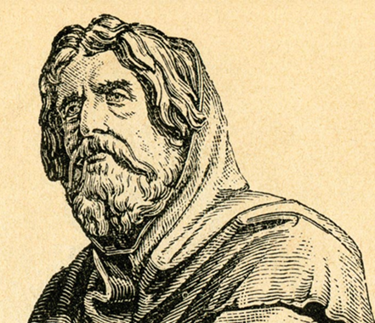
The Reformers of the Western Church, i.e. Roman Catholic Church
Peter Waldo (Walden) (1140–1205) was a wealthy and pious merchant living in Lyons, France, who through diligent reading of Holy Scripture came to the knowledge of the truth concerning salvation.
This spurred on additional study of the Scriptures that opened his eyes to the many errors and decadence of the Roman Catholic Church and its departure from the true path to salvation.

Slide 23
The Reformers of the Western Church, i.e. Roman Catholic Church
In 1170 he sold all of his processions and gave some proceeds as alms to the poor. At this point he took up traveling around the country teaching and preaching to the people. He had the four gospels translated into French for the people to read and study themselves.
His efforts produced people named the Waldensians and were known for only trusting Holy Scripture, and living peacefully in brotherly love. It was said at the time they led a purer life than other Christians.

Slide 24
The Reformers of the Western Church, i.e. Roman Catholic Church
The Roman Catholic Church was obviously very upset with Peter Walden and his followers, so much so he was excommunicated and forbidden to teach and preach. He did not do as directed and subsequently intense persecution was carried out by the Roman Catholic Church, both in southeastern France and Spain.
More than 1 million Waldensians were killed, by various means, in vain attempts to stamp them out.
Peter died naturally, in the Alps.
There are still Waldensians living in the Alpine area.
Notes:
Today you can still find remnants of these descendants in the Alpine areas of Savoy and Piedmont.
There is a Waldensian immigrant enclave in in North Carolia since the 1890s. They align with Reformed churches.

Slide 25
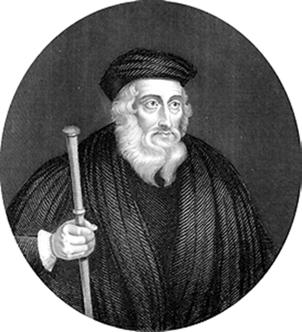
The Reformers of the Western Church, i.e. Roman Catholic Church
John Wycliffe (1320? - 84) was an English priest and reformer who, in later years, had a big influence on Jan Hus, and eventually, Martin Luther.
After graduating from Oxford University, he became a teacher there. His first pope run-in was over the pope’s claim to the right to levy church taxes, plus the appointment of men to church offices, without asking the King.
Notes:
1. The universities is where theology was taught for non-clergy teachers and clergy.

Slide 26
The Reformers of the Western Church, i.e. Roman Catholic Church
In 1377 he was brought to trial before the Archbishop of Canterbury and the Bishop of London, where he escaped punishment due to the efforts of his high-placed royal supporters in London.
The pope condemned his teachings at Oxford, but he continued to preach aggressively and without fear, all the while defending his attacks on church practices and beliefs.
When his attacks strayed from rich churchmen and started to include the rich nobility who fell into sin, Their support started to wane.

Slide 27
The Reformers of the Western Church, i.e. Roman Catholic Church
Following Wycliffe’s teachings, a new group called the Lollards formed. They emphasized personal faith and rejected church practices and beliefs that they claimed had no basis in the Bible.
They believed that all men should have free access to the Scriptures in their own language. Wycliffe was responsible for the translation of the Latin Bible into English.
The end of his movement came after the Peasants’ revolt of 1381 over the imposition of the unpopular poll tax of 1380.
Notes:
Lollardy was a proto-Protestant Christian religious movement that was active in England from the mid-14th century until the 16th-century English Reformation. I
The first full English translation of the Latin Bible, as the church officially banned any translation.
The Catholic Church affirmed the Vulgate as its official Latin Bible at the Council of Trent.

Slide 28
The Reformers of the Western Church, i.e. Roman Catholic Church
Wycliffe denied the doctrine of transubstantiation—that the substance of the bread and wine used in the Eucharist is changed into the body and blood of Christ. He denied that the church hierarchy represented a line of succession from Jesus and even equated the pope with the Antichrist.
He died a natural death.
The Council of Constance (1414 to 1418) posthumously charged him with heresy. They dug up his bones from the holy ground, burned them, and scattered his ashes in a river.
Notes:
. He lived and died as a Catholic.
This council has big impact on our next reformer.
3. Constance also is a beautiful lake on the boundary between Germany and Switzerland.

Slide 29
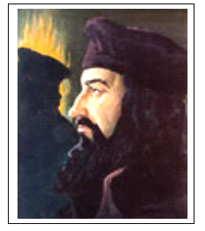
The Reformers of the Western Church, i.e. Roman Catholic Church
Jan Hus was born in Bohemia about 1369 and was executed on July 6, 1415. He spent his early years in the priesthood lecturing on philosophy in Latin. He also wrote and preached in his native Bohemian, something that just was not done in that day.
He agreed with many of John Wycliffe’s writings and thus became a thorn in the side of the church. When he protested the burning of Wycliffe’s books he was charged with heresy and forbidden to continue his teaching and preaching.
Notes:
Bohemia is a providence in modern Czeck Republic and Hus was stationed in Prague.
Often referred to as the first reformer.
He begin life as Catholic but was excommunicated.

Slide 30
The Reformers of the Western Church, i.e. Roman Catholic Church
Hus also protested the special indulgences proclaimed by Pope John XXII given to volunteers for an earlier crusade.
Sin was not forgiven through absolution alone as one also needed to undergo temporal punishment (penance) because one had offended Almighty God. Indulgences were also used for the sin of others, i.e. purgatory.
Indulgences emerged in the 11th and 12th centuries when the idea of purgatory took widespread hold and when the popes became the activist leaders in modifying the church and initiating Crusades.
Notes:
There were eight major official crusades between 1095 and 1270, as well as many more unofficial ones.

Slide 31
The Reformers of the Western Church, i.e. Roman Catholic Church
Hus opposed many aspects of the Catholic Church in Bohemia, such as its views on ecclesiology (study of church origins, etc.), simony (buying or selling spiritual gifts or positions), and other theological topics. (See Acts 8: 18-24)
Hus was a master, dean and rector at the Charles University in Prague between 1409 and 1410.
This was the time of a split in the Western church when there were two popes, conflicts galore and the sale of indulgences to raise money for political power reasons.
Notes:
Ecclesiology is the study of the Church in Christian theology.
It encompasses topics such as the Church's origins, its relationship to Jesus, its role in salvation, its polity, discipline, eschatology, and leadership.
Simony refers to the act of buying or selling spiritual gifts or positions. Named after Simon Magus, named in the NT.
Eucharist, dealing with the offering of one element or two.
These and other issues ha simmered for many years beforeHus

Slide 32
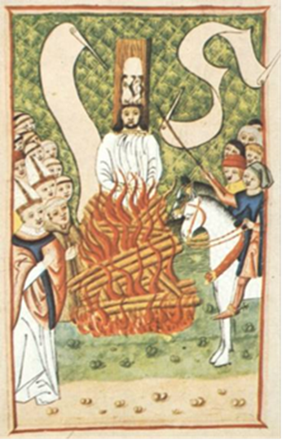
The Reformers of the Western Church, i.e. Roman Catholic Church
Hus was charged with Heresy, thus fearing for his life.
He was given safe passage to travel to the next council to be held in Konstanz, Germany, where he was to be tried.
The Bishop of Prague reasoned with the king that it was not required to keep his word with a heretic, causing the safe passage to be cancelled.
Hus was seized and held for trial at Konstanz and declared guilty.
He was burned at the stake all the while singing to the end.
Notes:
1. Konstanz is a beautiful little town on a lake by that name, which seperates Germany and Switzerland.
The fire was started by burning some of Wycliff’s banned books.
The wood was ignited, and Huss died while singing, “Jesus Christ, the Son of the living God, have mercy on me.”

Slide 33
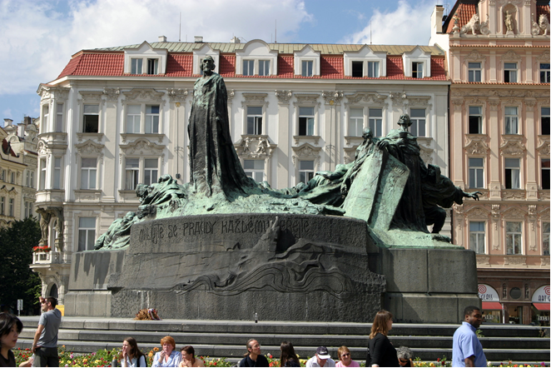
The Reformers of the Western Church, i.e. Roman Catholic Church
His response, “You are now going to burn a goose, but in a century, you will have a swan which you can neither roast nor boil.” (Fulfilled by Martin Luther.)
It was reported that much debauchery and drunkenness also took place, with more prostitutes present than council attendees.
Jan Hus Monument, Old Town Square, Prague
Notes:
1. The council ran over the course of three years.

Slide 34
The Reformers of the Western Church, i.e. Roman Catholic Church
The death of Jan Hus kicked off a string of events lasting years.
In 1415 the Hussite/Catholic war broke out in Bohemia and Monrovia (Monravia). Historically this area was Byzantine.
With peace coming in 1436, this was, in essence, a reformation.
Four articles of agreement ensured all the principal gains of the war: communion in both kinds, the expropriation of church lands (which broke the economic power of the Roman Catholic Church in Bohemia), preaching in the native language, and an independent Bohemian Catholic church.
Notes:
The Catholic League was essentially the army of the Holy Roman Empire Empire.
Hussite churches still exist in Eastern EU and in North America.
The Thirty Years' War (1618-1648) was a devastating conflict primarily fought in central Europe, marked by religious strife and political power struggles. It involved various nations and resulted in approximately 8 million casualties, making it one of the longest and most brutal wars in history.

Slide 35
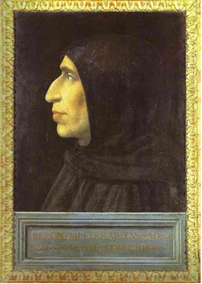
The Reformers of the Western Church, i.e. Roman Catholic Church
Girolamo Savonarola (1452-98) was a popular religious and political reformer in Florence, arriving in 1490.
He was famed as a fiery preacher and prophet throughout Italy. He preached boldly against abuses in the church and government, with great success and drew huge crowds to church.
He introduced many civic reforms, including a democratic city government, but then was declared a heretic.
On May 23, 1498 he and 2 others were hanged and then burned at the stake.
Notes:
The de’ Medici family headed up a large banking empire located in Florence that bankrolled the Italian Renascence.
He was a Dominican frier.
He did not preach against catholic theology.

Slide 36
The Reformers of the Western Church, i.e. Roman Catholic Church
His preaching led to a great revival in Florence, which only increased his control of the city upon de’ Medici death in 1492.
Savonarola fell from favor due to the sin in church and state.
Alexander VI was the current pope. It was the low point of the papacy. (One of the string of “bad popes”)
Alexander was a member of the notorious Borgia family. Known for his immorality, Alexander had numerous mistresses and illegitimate children.
Notes:
The house of the Borgias produced two popes Callixtus III and Alexander VI, plus many other political and church leaders. Some members of the family became known for their treachery.
For the horrible details see the book The Bad Popes.
The Bad Popes is a 1969 book by E. R. Chamberlin documenting the lives of eight of the most controversial popes (papal years in parentheses):

Slide 37
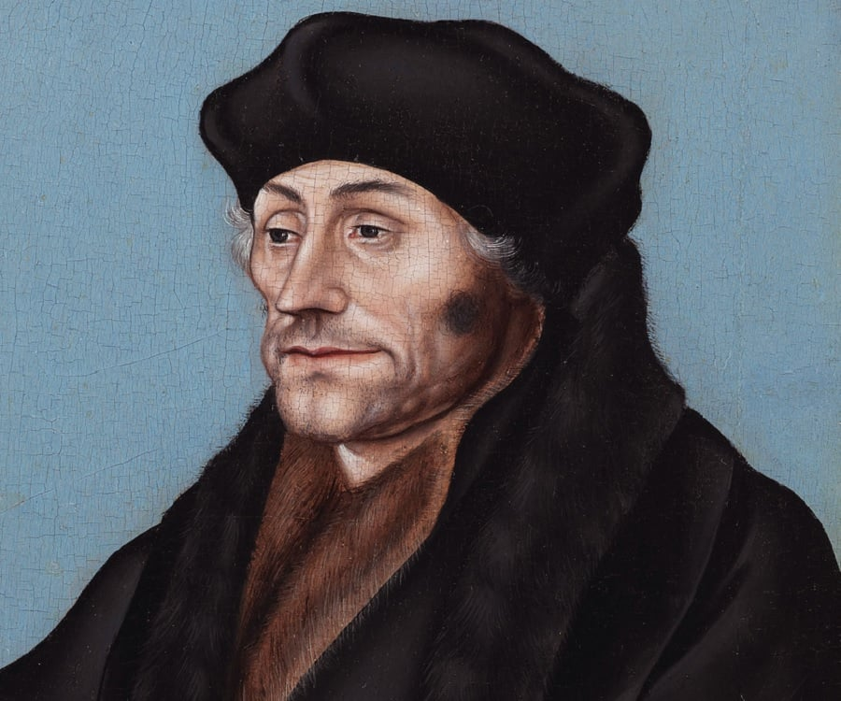
The Reformers of the Western Church, i.e. Roman Catholic Church
Desiderius Erasmus (1466?-1536), a famous Dutch Renaissance scholar and theologian, published three books taking solid aim at the foundation of the Roman Catholic Church.
He also wrote Letters of Obscure Men, which discredited the monastic system, making the system the laughing stock of Europe.
He was the forerunner of Luther in the study of the early church and published copies of the New Testament in Greek.
Subsequently, this led to the abandonment of countless monasteries.
Notes:
Foundation was rooted in Scholasticism and Aristotelianism.
This is the source of Greek NT that Luther and others used.
He never left the Roman Catholic Church

Slide 38
The Reformers of the Western Church, i.e. Roman Catholic Church
These Greek translations only became available from the scholastics and clergy fleeing from the defeat of Constantinople in 29 May 1453 by the Ottoman Empire (Muslims).
Muslim conversion was by means of the sword.
None of the earlier reformers had access to accurate Greek manuscripts of the New Testament because of the exclusive use of Latin by the church.
Latin obscured the true meaning of the doctrine of Grace by Faith alone, but is made clear in the Greek (by Luther).
Notes:
The fall of Constantinople was accomplished by the Ottoman Empire and spelled The end of the Byzantine Empire.
2. Faith alone was one of three keys to Martin Luther’s stand against the Catholic Church.

Slide 39
The Reformers of the Western Church, i.e. Roman Catholic Church
During the unification of Spain (completed in 1492) under Ferdinand and Isabella, another reformation (of sorts) took place in Spain, spearheaded by John of the Cross, a monk, and Theresa of Avila, a nun.
This effort addressed some of the corruption and irreligiousness of the clergy and orders, and was carried out quietly within the orders themselves. It had little public impact and none of the volatility that was evident in Luther’s time.
Confined to Spain only.
Notes:
Hence the severity of the Spanish Inquisition of 1478.
The reign of King Ferdinand II of Aragon and Queen Isabella I of Castile, spanning from 1474 to 1516, marked a pivotal period in Spanish and world history. Their marriage united the powerful kingdoms of Aragon and Castile, laying the groundwork for the unification of Spain.

Slide 40
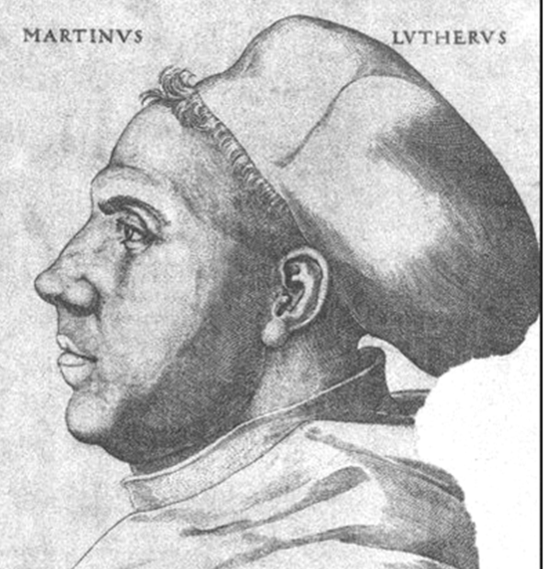
The Reformers of the Western Church, i.e. Roman Catholic Church
Martin Luther was born to poor peasant parents in Eisleben, Germany, on 10 Nov. 1483 and christened on 11 Nov, on St. Martin’s Day at St. Peter and Paul church. He died on 18 February 1546 (heart attack).
Johann Sebastian Bach was baptized in Eisleben at the Georgenkirche (church) some two hundred years later.
Luther obtained his Master’s Degree at the University of Erfurt while studying to be a lawyer. He had a very strong talent for music.
Notes:
In Eisleben the family name was actually Luter.
Bach became the Director of music at St. Thomas church in Lipzig, where the St. Thomas Boys Choir still sings to this day..
2. His father was furious when he learned Luther’s enrollment in the monastery. How were the elderly supported?
3. What Iis the difference between a frier and a monk?

Slide 41
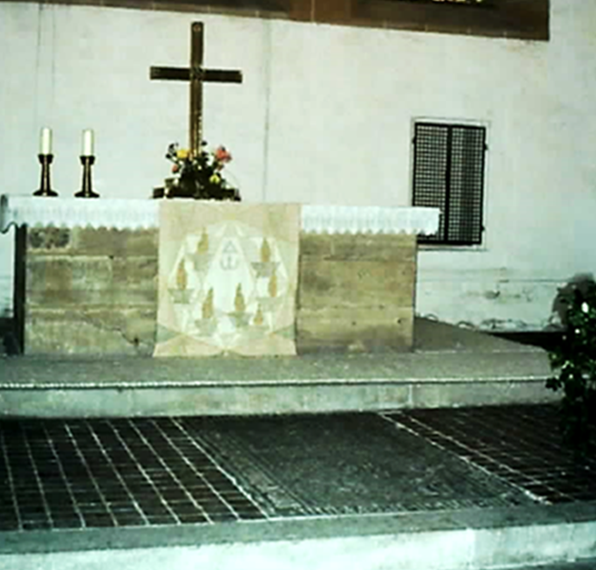
Altar in the Caple of the Franciscan Monastery, Erfurt, Germany.
He took his vows as a friar at the age of 23, laying face-down on the grave of Johannes Zachariae who was the prosecutor of Jan Hus.
Grave is visible in the foreground.

Slide 42
The Reformers of the Western Church, i.e. Roman Catholic Church
Luther was ordained a priest in 1507, and often preached at St. Mary’s Cathedral in Erfurt.
9 March 1509 Baccalaureus Biblicus awarded to Martin Luther, followed in the fall with a Baccalaureus Sententiarius at Erfurt University.
1510-11: Luther’s pilgrimage to Rome, where he was disillusioned over the moral decay among the clergy in Rome, particularly about the Eucharist.
He was transferred to the University of Wittenberg mid-1511 to teach theology.
Notes:
One year after taking his vows to be a friar.

Slide 43
The Reformers of the Western Church, i.e. Roman Catholic Church
Luther received his doctorate at the Castle Church in late 1512 and also elected to be sub-prior of his monastery.
In 1517 he posted the 95 theses, written in protest when Pope Leo X announced a ‘plenary indulgence’.
It provided total exemption from Purgatory for those who donated money towards the building of St. Peter’s Basilica in Rome. Luther was outraged.
Thanks to someone translating the theses into German and the new-fangled Gutenberg printing press, the theses wound up being distributed all over Europe.
Notes:
Such a posting was the normal sequence for a scholastic debate and it was not a rebellion against the church.
Luther’s approach was greatly different than other reformers.
Gutenberg press.
Pope Leo X was from the Medici family of Florence.
It bums me out knowing the Basilica was built on indulgence money.
2.

Slide 44
The Reformers of the Western Church, i.e. Roman Catholic Church
After two notable debates and threats from Rome to rein in Luther he was excommunicated and labeled a heretic.
Frederich the Wise, current Duke of Saxony, refused to send him to Rome for trial while stating any trial would need to be held in Saxony.
The Lutheran Reformation was on and the rest is history!
Luther based his tactics on the correct belief that if something contradicted what the Bible taught, then the church should not be doing it.
Notes:
1. Luther was a fierce debater and took no prisoners.
The Duke was the second most important person in the Holy Roman Empire.
Here is the concept of Adiaphora.

Slide 45
The Reformers of the Western Church, i.e. Roman Catholic Church
Luther’s approach was to remove those items from Church practices not supported by the Bible.
His first efforts were to modify the mass and introduce the singing of hymns, in German.
He also introduced the Doctrine of Vocation.
Throughout the 1520’s he further developed the theology which came to be known as Orthodox Lutheran.
He, the duke, and the emperor, all petitioned Rome for a church counsel to discuss these important issues. Denied.
Notes:
Up of hymns introduced a teaching method for the learning of Scripture.
Up until this time only church workers had a vocation. Anything else had no value.
The General Council of Trent was finally held from 1545-63 A.D., starting later in the same year that Luther died.

Slide 46
The Reformers of the Western Church, i.e. Roman Catholic Church
In addition to composing many hymns he was a voracious writer, from books to tracts, keeping the presses going in three towns.
He collected no royalties.
In conjunction with Cranach the Elder, a new form of religious art was created.
The Jesuit Order was founded in 1540 with direct allegiance to the pope to counteract the Lutheran Reformation.
Martin Luther remains one of the most influential figures in Western and Church history.
Notes:
1, Lutheran primarily but other reformations as well.
2. He is widely regarded as one of the most influential figures in Western and Christian history.

Slide 47
The Reformers of the Western Church, i.e. Roman Catholic Church
His beliefs and teachings on the authority of Scriptures (not man) and salvation by faith alone helped turn the Western Church from darkness to light.
Luther married a former nun, Katherine (Katie) von Bora.
Later, Lutheran theology was influenced by John Calvin, causing a major split and the creation of what became known as Reformed Lutheran. (Also, Melanchthon)
Historically, in Germany there were two denominations of Lutherans, Orthodox and Reformed.
Notes:
Orthodox equals SELC (Independent Evangelical-Lutheran Church) and Reformed equal The Evangelical Church in Germany (EKD)
Luther was named the most important man of his century.

Slide 48
The Reformers of the Western Church, i.e. Roman Catholic Church
Now, the Reformed are not all Lutherans, so the Independent Evangelical Lutheran Church – SELK, remains as the only truly Orthodox Lutheran Church in Germany.
Currently in the US there are at least seven Lutheran denominations, some orthodox, some liberal, some a mixture of both.
Denominational splits are generally along conservative versus liberal lines, regardless of the denomination.
Notes:
Vatican I was held on December 1869 and was adjourned on 20 September 1870 and Vatican II was held in 1962 to 1965.
Vatican I had mostly to do with the new state of Italy encroaching upon the Papak States.

Slide 50
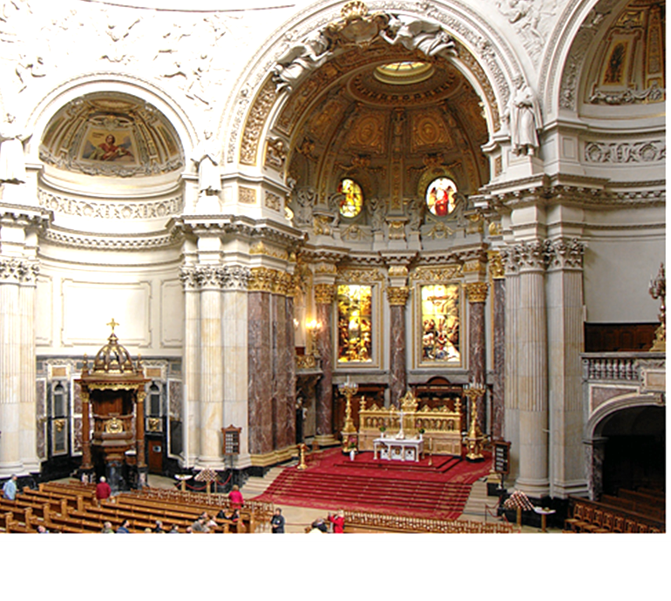
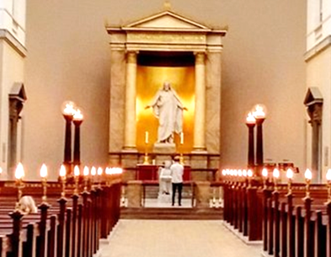
Berlin Cathedral Copenhagen Cathedral
Notes:
1. Berlin Cathedral (Domkirche)
2. Castle Church, Torgue, Germany.

Slide 51
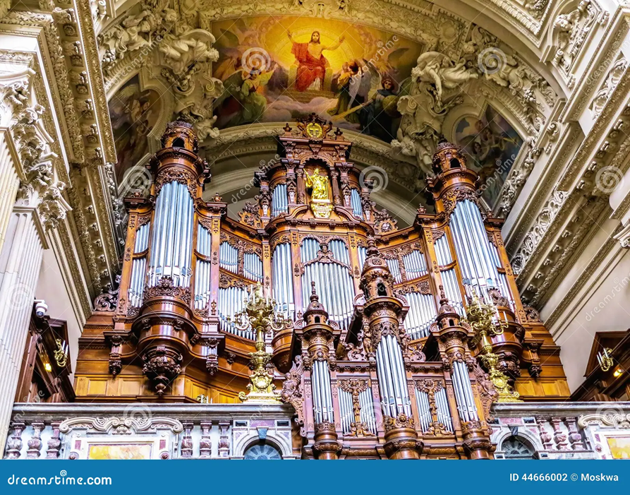
Organ of Berlin Cathedral (114 stops)

Slide 52
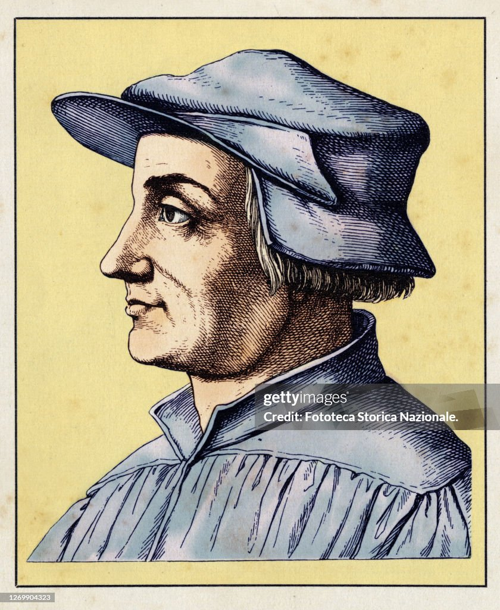
The Reformers of the Western Church, i.e. Roman Catholic Church
Ulrich Zwingli (January 1, 1484-October 11, 1531) born Wildhaus, Switzerland.
Died, near Kappel in battle.
He was the most important reformer in the Swiss Protestant Reformation.
He founded the Swiss Reformed Church.
Important figure in the broader Reformed tradition.

Slide 53
The Reformers of the Western Church, i.e. Roman Catholic Church
Like Martin Luther, he accepted the supreme authority of the Scriptures, and applied it rigorously and comprehensively to all doctrines and practices.
He was sympathetic toward the Renaissance movement and valued his correspondence with Erasmus.
Zwingli at once began to preach his new convictions including topical criticism of abuses, and did not at first attack traditional positions, being content to expound the regular Gospel passages.

Slide 54
The Reformers of the Western Church, i.e. Roman Catholic Church
In 1518, despite much opposition, he was appointed people’s priest at the Grossmünster (Great Minster) at Zürich.
In 1520, by permission from the city’s governing council he preached the “true divine scriptures.”
His resulting sermons helped to stir revolts against fasting and clerical celibacy that contributed to the Swiss Reformation (1522).
Notes:
There is a statue of him in the courtyard.
The Church was a thousand years old before it definitively took a stand in favor of celibacy in the twelfth century at the Second Lateran Council held in 1139, when a rule was approved forbidding priests to marry. In 1563, the Council of Trent reaffirmed the tradition of celibacy.

Slide 55
The Reformers of the Western Church, i.e. Roman Catholic Church
A printed version of the Oetenbach addresses, The Clarity and Certainty of the Word of God, appeared in 1522.
Steps taken during 1524 and 1525 included: the removal of images, the suppression of church organs, the dissolution of religious houses, replacing the mass with a simple Communion service, reforming the baptismal office, introduction of prophesyings or Bible readings, reorganizing the ministry, and the preparation of a native version of the Bible (the Zürcher Bibel appeared in 1529).
Notes:
Monasteries and nunneries.

Slide 56
The Reformers of the Western Church, i.e. Roman Catholic Church
Zwingli was a contemporary of Luther, but they disagreed on several points, such as;
Infant Baptism versus an age of accountability. (Mark 10: 13-16) (Acts 10: 47-48)
True presence in the bread and wine versus a remembrance. (Roman Catholic: 2 elements become 2 different elements; Lutheran: 2 elements become 4 elements; Reformed: 2 elements remain 2 elements)
The presence of art in the sanctuary versus austere chancel and nave. (Teaching Scripture lessons versus no lessons to be learned)
Singing of hymns based on scripture versus singing Biblical psalms.
Notes:
1.

Slide 57

The Reformers of the Western Church, i.e. Roman Catholic Church
John Calvin, born Jean Calvin (1509 – 1564) was a French theologian, pastor, and leader of the reformation.
Calvin attended the University of Paris in 1523 to prepare for his priesthood. But then Calvin’s father changed his mind and decided that his son would become a lawyer.
In 1528, Calvin moved to Orleans, France, to study civil law.
Notes:
1. Calvin held that the Roman Catholic Church was so corrupt it could not be reformed, so he started over with a blank piece of paper.

Slide 58
The Reformers of the Western Church, i.e. Roman Catholic Church
His teachings and works, chiefly the Institutes of Christian Religion, played a significant role during the reformation and still influences many Christians today.
During his studies, Calvin became exposed to Renaissance Humanism—a movement that sought to reform the Church through a study of the Bible in its original language.
Humanism thus was against Rome by opposing the use of Latin in all things.
Notes:
2. Also, the use of logic to explain all things.

Slide 59
The Reformers of the Western Church, i.e. Roman Catholic Church
Humanism in the Renaissance sought to place humans at the center of intellectual pursuits and included the application of logical reasoning.
By 1532, Calvin finished his studies and published his first book, which was a commentary on Seneca’s DeClementia.
His second book, The Institutes, a theological defense of the reformation, was published in 1536.
He was forced to leave France and settled in Geneva where he began teaching and preaching (without credentials).
Notes:
Science and logical reasoning held center stage in education.
Seneca's De Clementia is an instructional contrast between the good ruler and the tyrant, and an evaluation of the relationship between ruler and subject and the need for mercy during the time of Nero.
He did not have a degree in theology.

Slide 60
The Reformers of the Western Church, i.e. Roman Catholic Church
Along with William Farel, they began making changes that were not universally popular in the local church.
In 1538, both were removed from Geneva, with Calvin settling in Strasbourg, France, where he continued to teach and preach.
In 1541, the city of Geneva invited him to return, spending the remainder of his life there and overworked himself with preaching, teaching, and writing. When people urged him to rest, he replied, “What? Would you have the Lord find me idle when He comes?”
Notes:
1. He founded the Calvinist Church.

Slide 61
The Reformers of the Western Church, i.e. Roman Catholic Church
He opined that the Catholic Church was too corrupt to be reformed. So, he started over from scratch to start a new theology and denomination.
His most quoted theory was that of Predestination, whereby it is already decided by God if when you die your soul will go to heaven or hell. (Not Scriptural)

Slide 62
Post Reformation Events
If one considers that a reformer’s attainments need to last hundreds of years, then it could be said that only Hus, Luther, Zwingli, and Calvin qualify as effective reformers.
Among these four reformers, Luther had the strongest education in theology, plus he had big impacts in literature, music, and art.
Other reformers primarily focused their effort at theology and societal changes.
The reformation era essentially ended in the mid-1500s: to be followed by reorganization or denominational splits.

Slide 63
Post Reformation Events
Among present-day Christians, Hussite traditions are represented in denominations which call themselves Moravian or Unity of the Brethren churches and in the more recently founded Czechoslovak Hussite Church.
The latter founded by rebellious Roman Catholic priests after WW I.
Among Christians, Lutherans adhere to the Augsburg Confession found in the Book of Concord, 1580 version.
Through missionary efforts, Lutherans have a world-wide presence.

Slide 64
Post Reformation Events
Calvin’s most famous disciple was John Knox, (1514–1572) a Scotsman, who returned from France and founded the Presbyterian Church in the 1500’s.
Luther’s most famous disciple was the Rev. Bugenhagen who went to Sweden upon the invitation of the Swedish King to introduce the Lutheran religion there in 1527. The crown took all Catholic property.
King Henry VIII broke with Rome and started the Anglican Church in 1534.
A mixture of Roman Catholic, Lutheran and Calvin theology.
A later split formed the Methodist Episcopal Church in the US.
Notes:
1. The Methodist Episcopal Church (MEC) was the oldest and largest Methodist denomination in the United States from its founding in 1784 until 1939. It was also the first religious denomination in the US to organize itself nationally.^{[4]} In 1939, the MEC reunited with two breakaway Methodist denominations (the Methodist Protestant Church and the Methodist Episcopal Church, South) to form the Methodist Church. In 1968, the Methodist Church merged with the Evangelical United Brethren Church to form the United Methodist Church.

Slide 65
The Reformers of the Western Church, i.e. Roman Catholic Church
Henry was excommunicated by Rome but continued to practice his Catholic faith.
Ann Boleyn, his second wife, was a Lutheran and pregnant with a baby girl when they married.
Henry never became a Protestant himself. However, Edward VI, the son he eventually had with this third wife Jane Seymour, was raised Protestant.
The Catholic monasteries were closed and the lands and treasures were sold with the proceeds going to the crown.
Notes:
1. Thus, the saga of the Tutors continues.

Slide 66
THE END
Thank you for attending

